Slide 1
IoT Attack and Security Analysis in Edge Computing Network

Slide 2
Introduction and Problem Statement
The rapid growth of IoT devices has increased security concerns, especially in edge computing environments.
Edge computing enhances efficiency but is highly vulnerable to cyber threats like: 1. Unauthorized access 2. Data breaches 3. Device manipulation
This project proposes a real-time IoT attack detection framework using Machine Learning techniques.

Slide 3
Solution
This project focuses on detecting and mitigating IoT attacks using an Attack Detectable IoT System integrated with: 1. Smart Environmental Monitoring Sensor 2. Smart Bulb 3. Buzzer
The system addresses four major cyber threats: 1. Denial of Service (DoS) 2. Command & Control (C&C) 3. PartOfAHorizontalPortScan 4. FileDownload
Machine Learning based Attack Detection is implemented, with XGBoost achieving 94.85% accuracy, making it the preferred model.

Slide 4
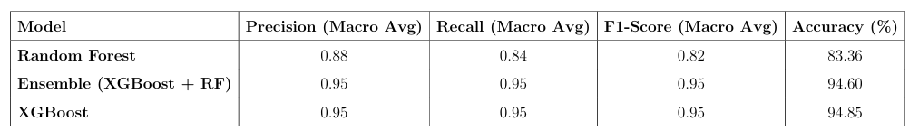
Results
Comparison of Machine Learning Models

Slide 5
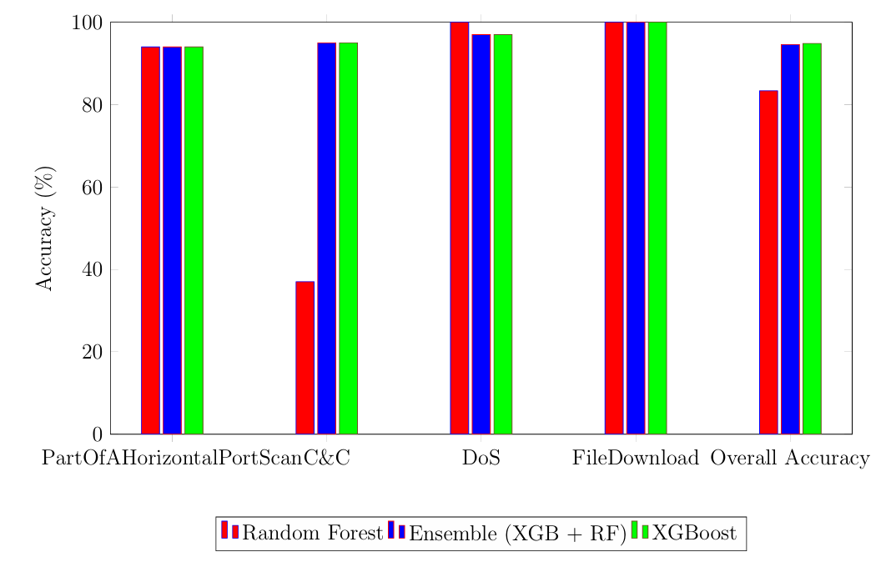
Results
Performance Comparison for IoT Attack Detection

Slide 6
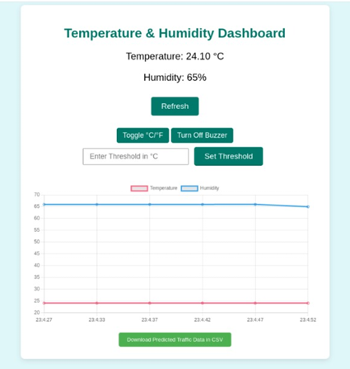

Dashboards

Slide 7
Hardware Technologies
Raspberry Pi 4 Model B
DHT11 Sensor
LED
Buzzer

Slide 8
Software Technologies
Operating Systems:
Raspberry Pi OS
Kali Linux
Programming Environment:
Python
Numpy
Scikit-Learn
Matplotlib
Web Framework:
Flask

Slide 9
Software Technologies
Front-End Web Development:
HTML
CSS
JavaScript
Network Monitoring Tool:
tcpdump
Machine Learning Models Used:
Random Forest
Ensemble
XGBoost

Slide 10
Conclusion
The Attack Detectable IoT System integrates Smart Environmental Monitoring Sensors and Smart Bulbs with a web interface for real-time monitoring and attack management.
XGBoost model (94.85% accuracy) outperformed other models, making it the preferred choice for attack classification.
Real-time network traffic captured using tcpdump demonstrating real-world applicability.
Detected unauthorized access and providing real-time attack logs for proactive threat management.

Slide 11
Thank You!

